Slide 1
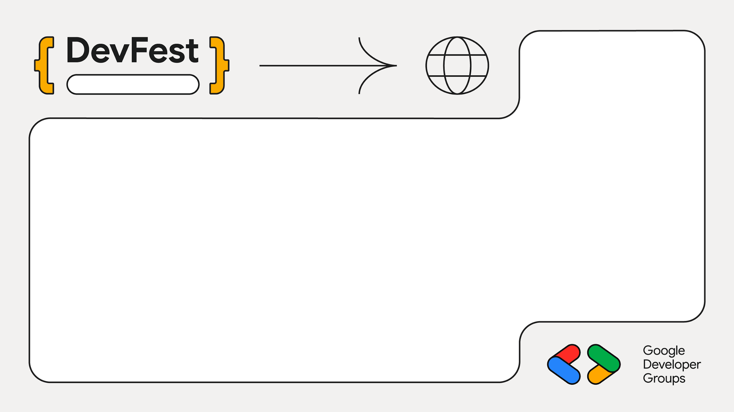
2025
Sarit
Building Technology for Social Impact
Oliver Wainaina
Tech Lead, Sauti Salama; Tusonge

Slide 2
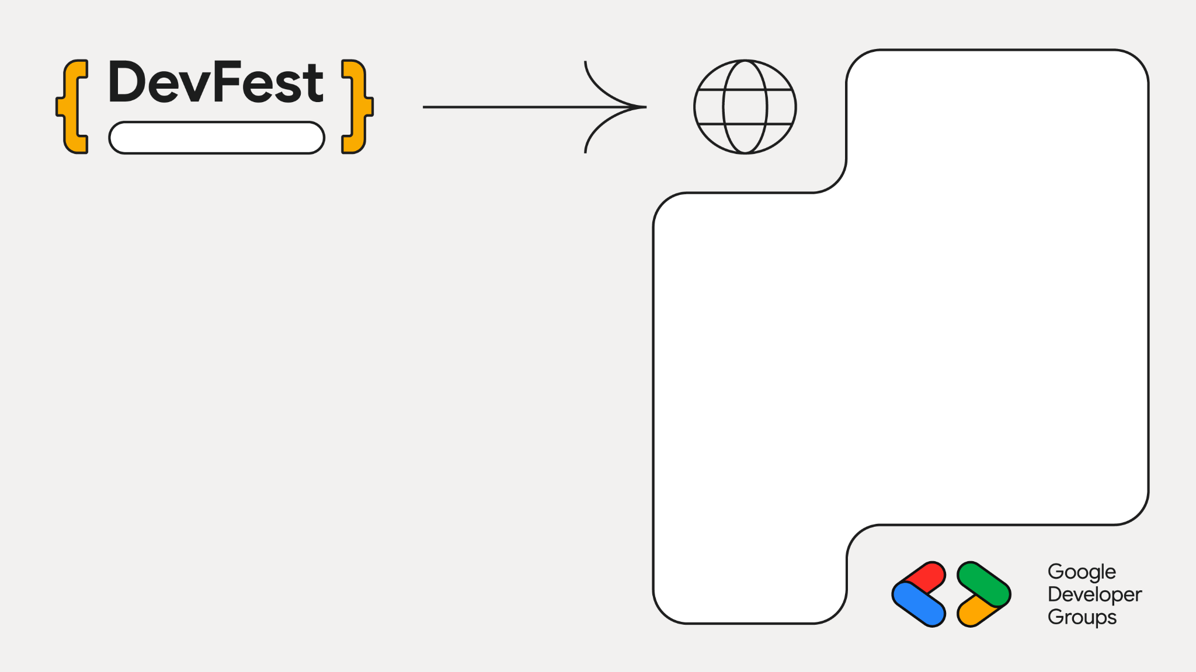

Sarit
From Curious Beginner to Founder
The Spark: First time at a computer
Software Dev → Pitch Preneur → Social Impact Tech Lead.

Slide 3
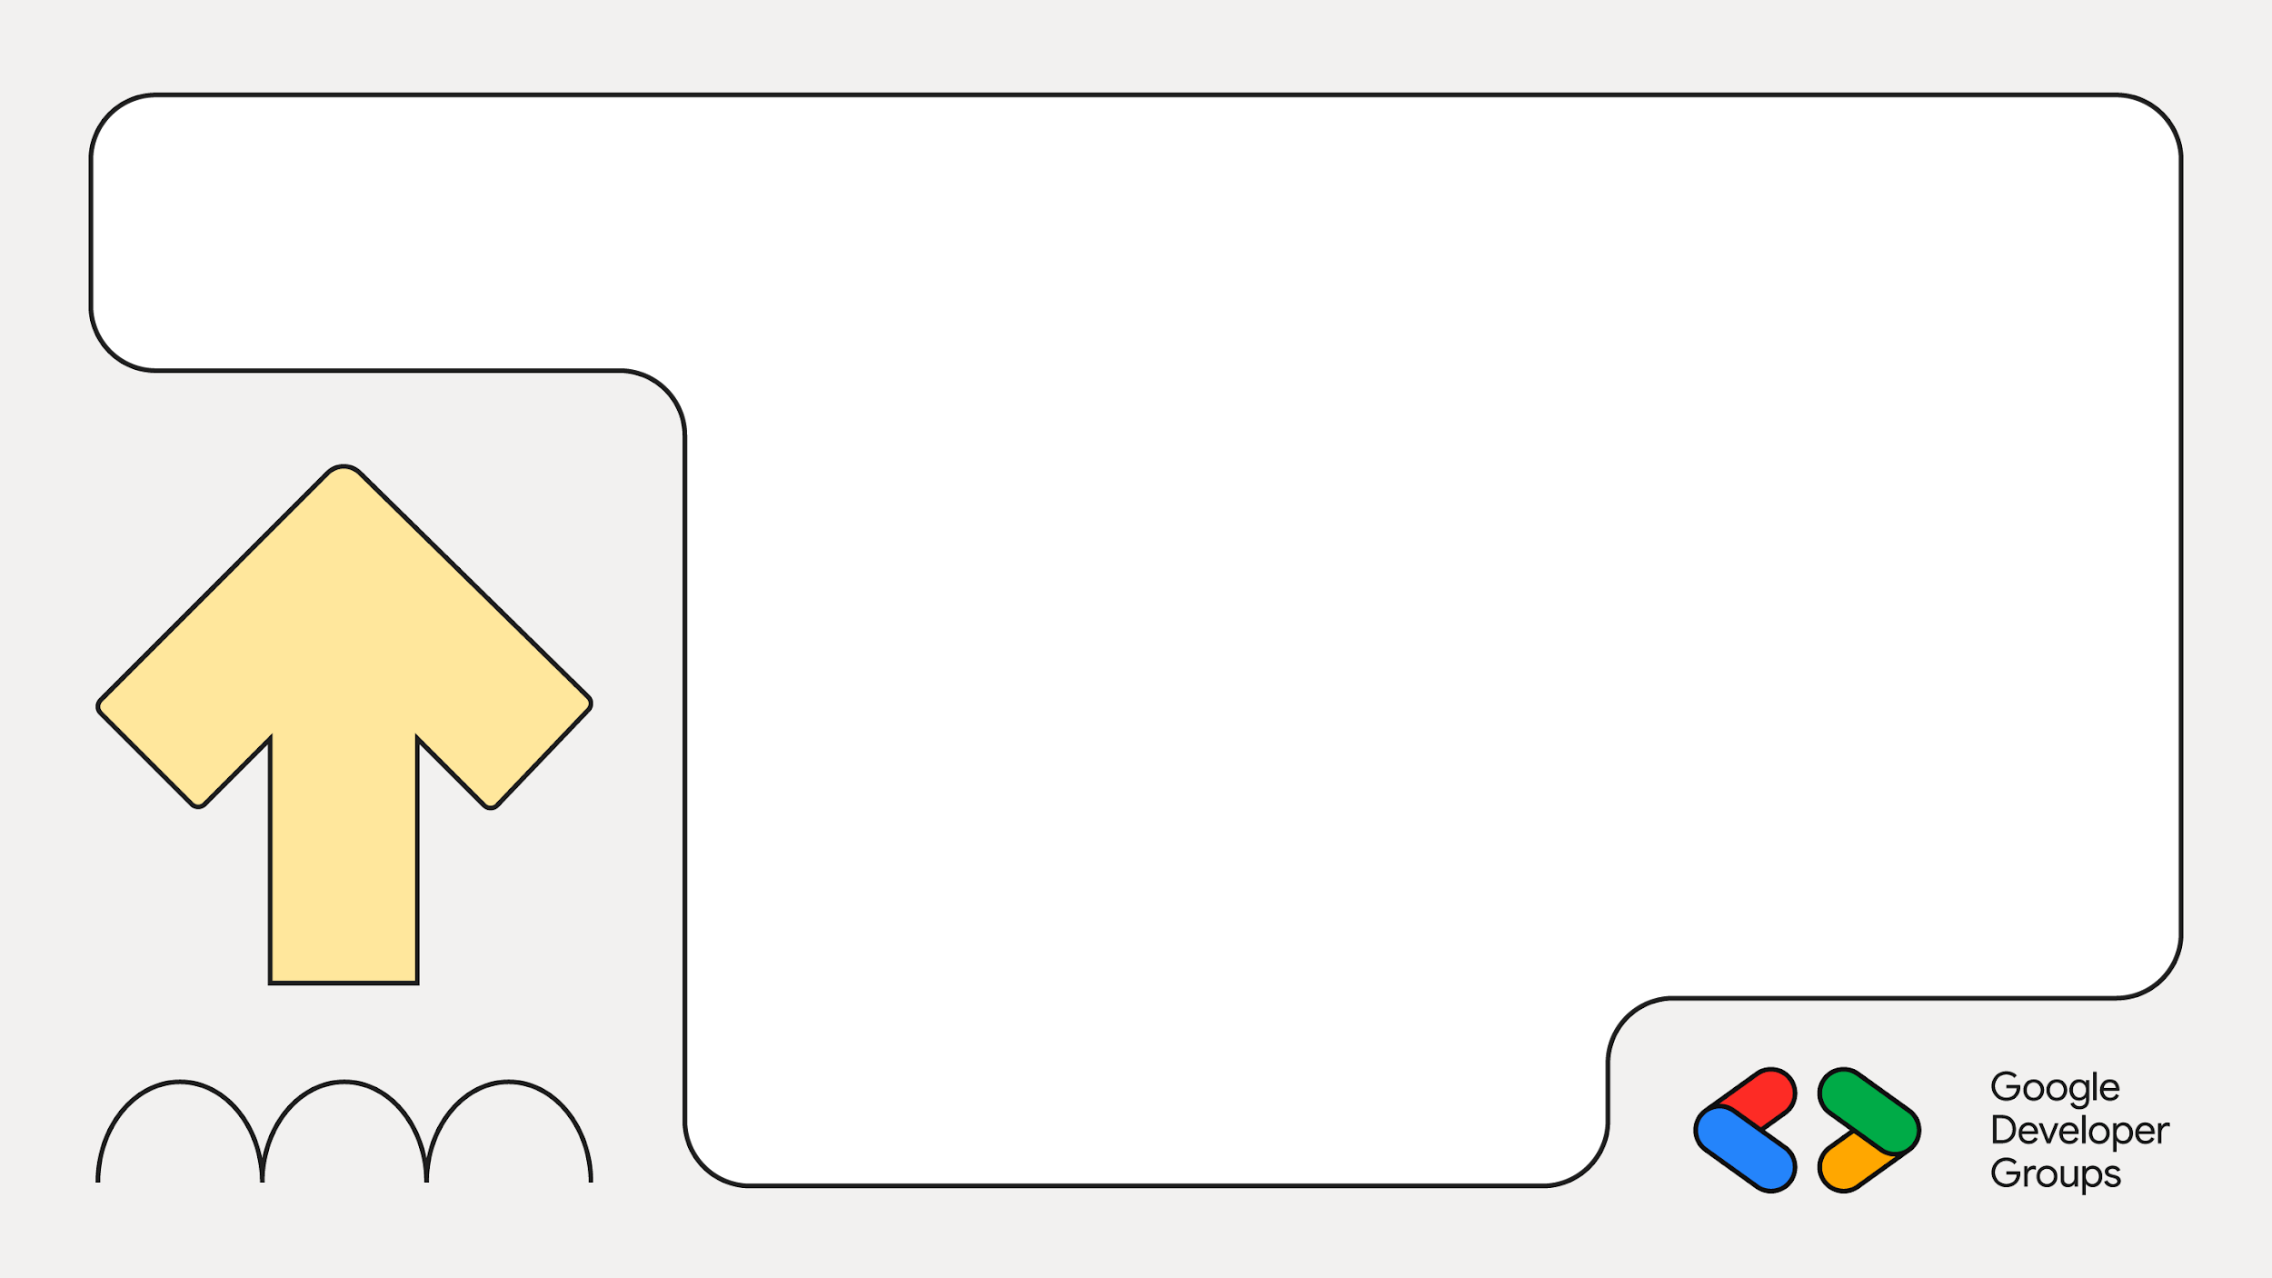
02
The Problem: Pain Is the Currency
Case Study:
Witnessing abuse and listening to stories of abuse.

Slide 4

44%
More than
Of Kenyan women experience abuse at one point in their lives

Slide 5
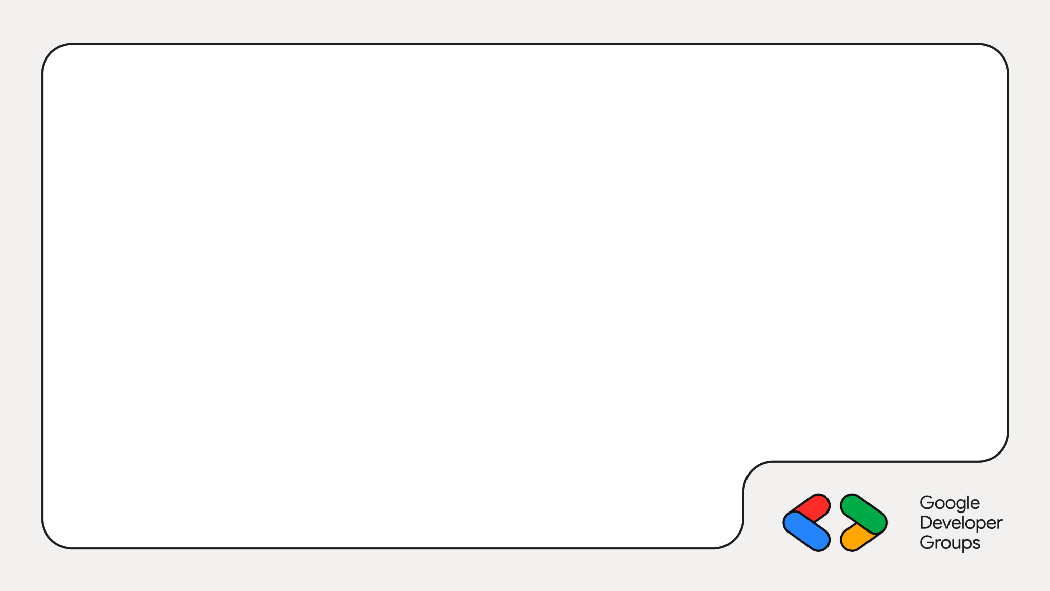
The Reporting Barrier:
Why the statistics are low
Stigma: Not a problem for the marginalized alone; wealthy and men suffer in silence too.
High Cost: Loss of credibility for professionals (the ultimate vulnerability).

Slide 6
03
Flaw in Digital-First Thinking
How many of us have kenyan apps made by other people (not safaricom / mpesa)?

Slide 7
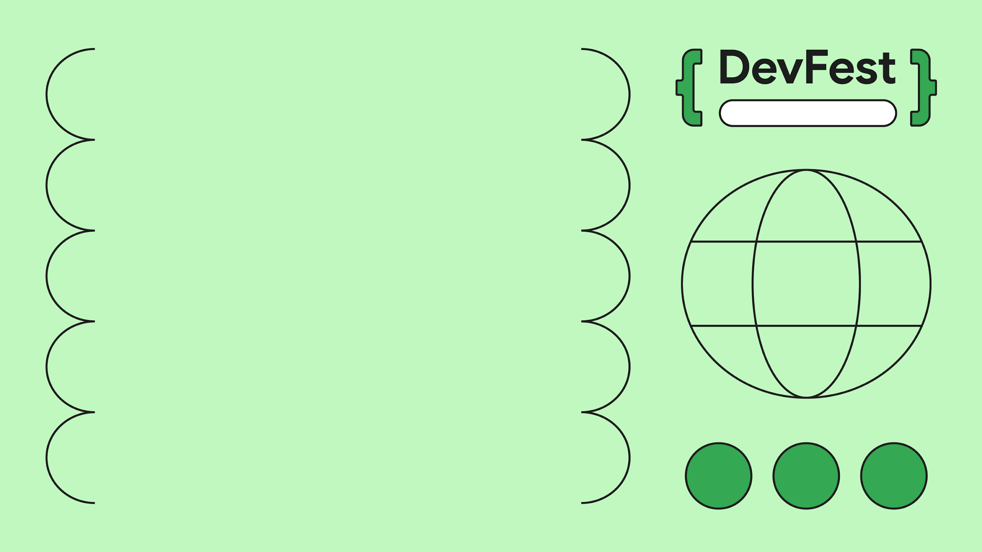
Sarit Centre
The Pre-Scale Rule: First, we must build a personal, face-to-face (F2F) solution (trust), and then build software to automate and scale.

Slide 8

Introducing…

Slide 9
03
Designing from First Principles:
Building With, Not For

Slide 10
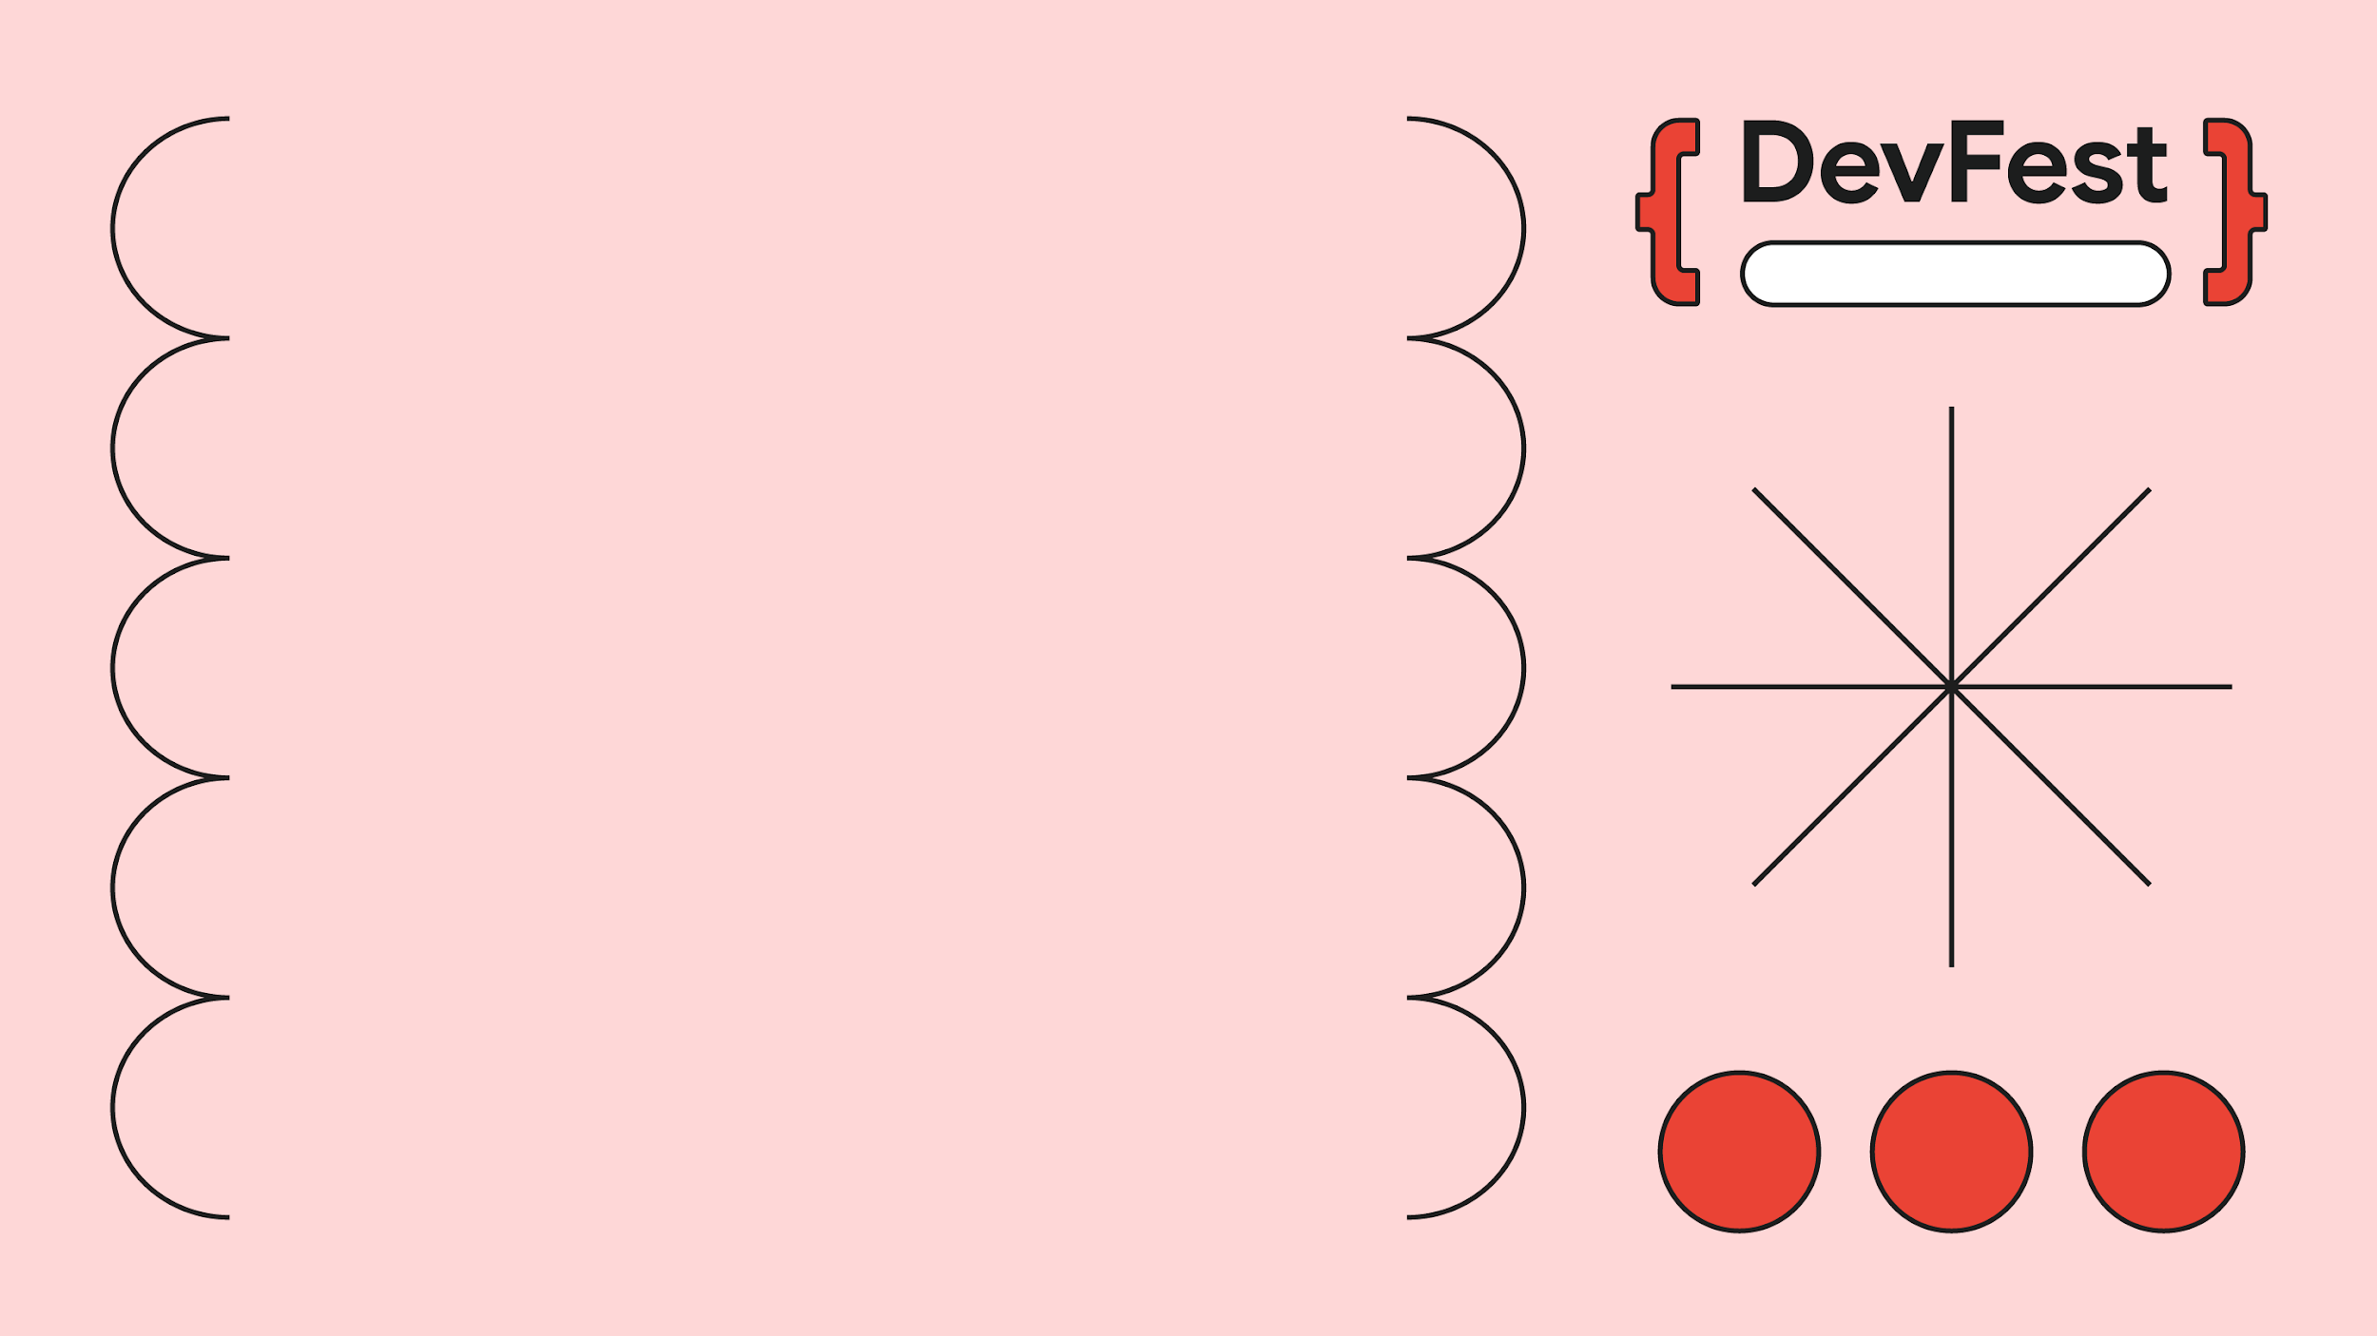
Sarit Centre
The Principle: "If I am not in the room and the solution is meant for me, then the solution is against me."

Slide 11
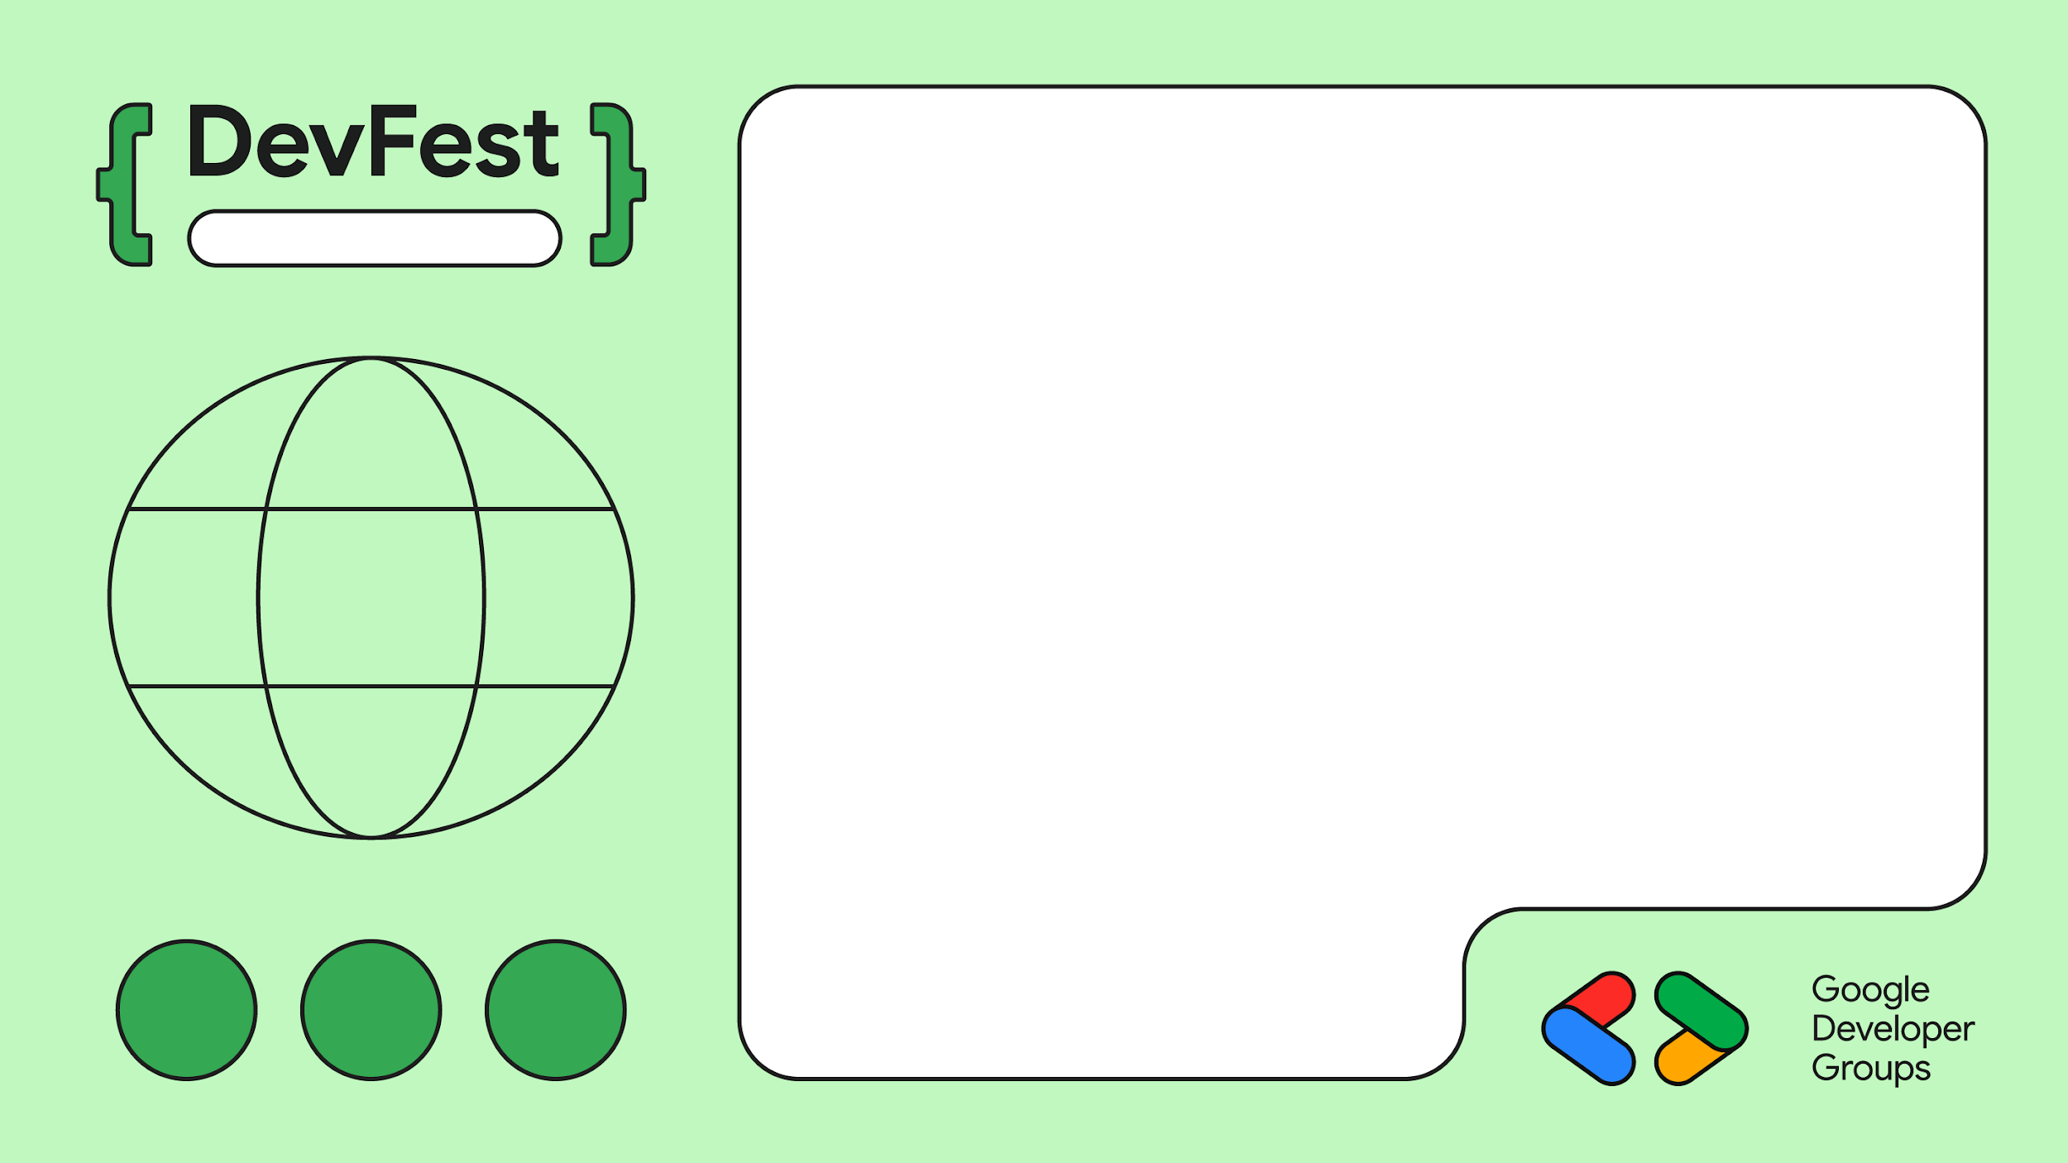
Sarit Centre
Empathy Mapping
Building with Privacy in mind (not just a legal clause). The solution must not compound builders' pain points only.

Slide 12

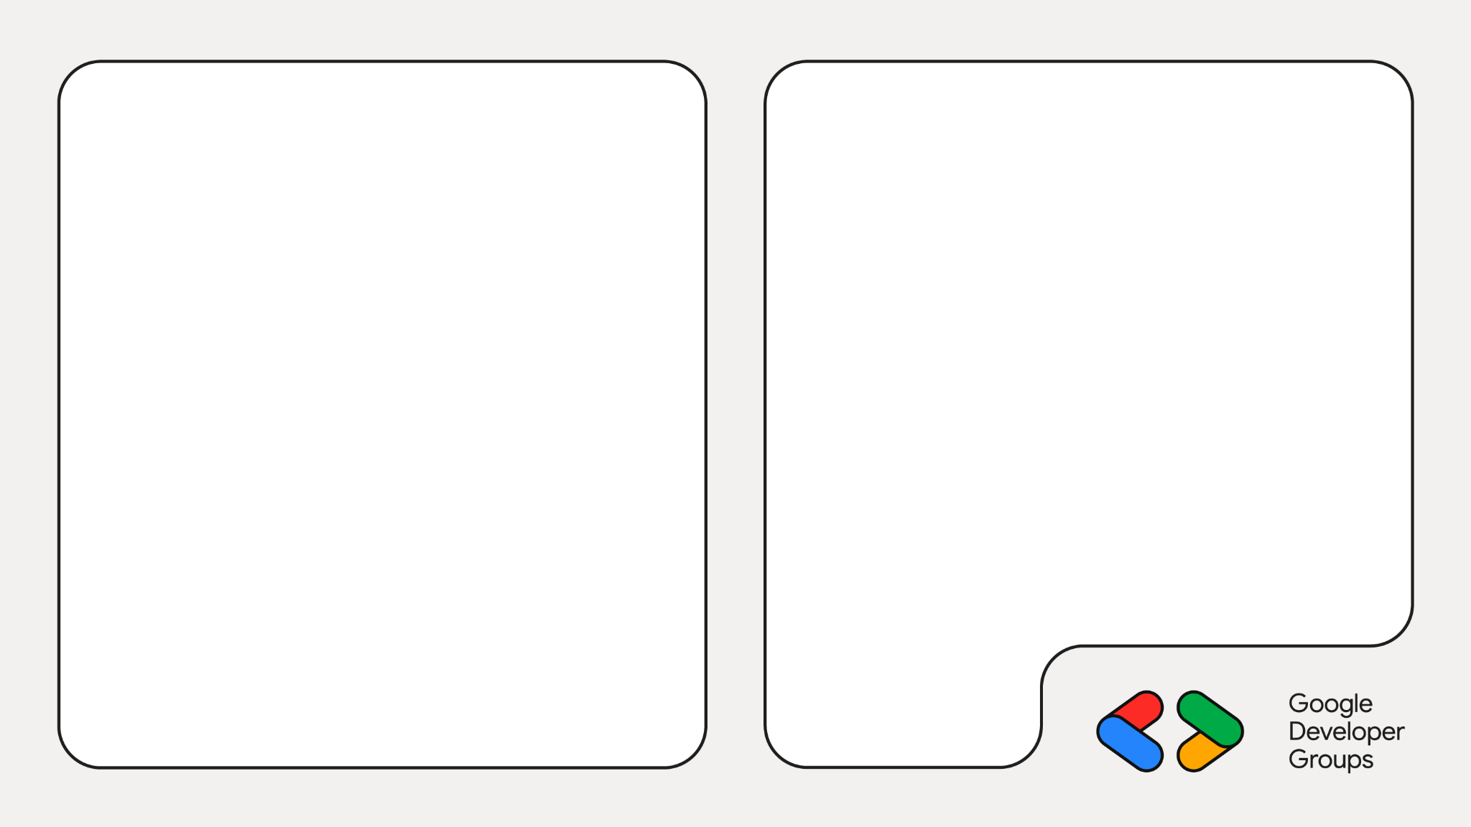
Survivors Caffe sessions were used to get feedback from survivors

Slide 13
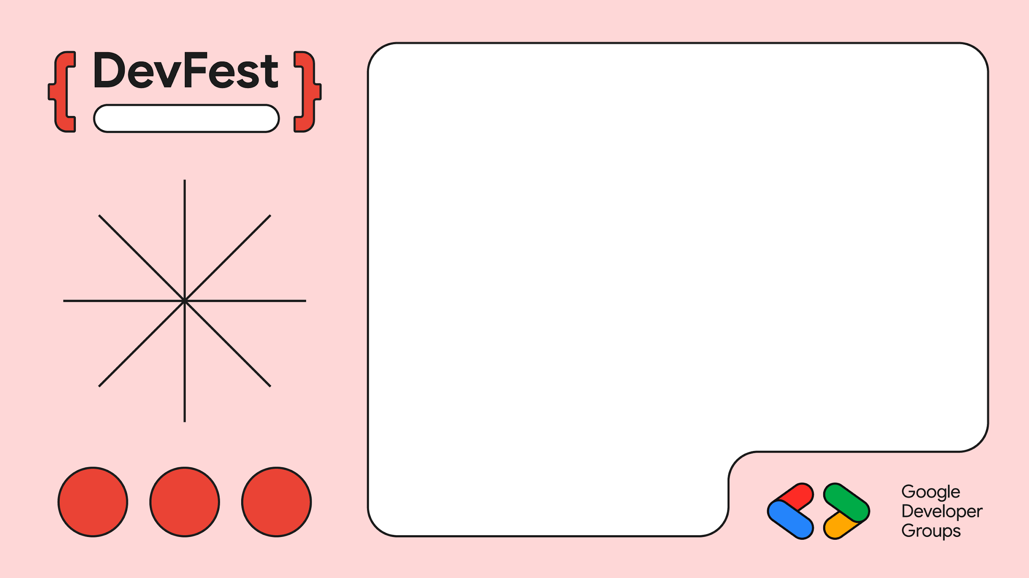
Sarice Centre
Empathy Mapping
Flutter App
Web App

Slide 14
04
Building a Safe Digital Haven on the Cloud
Google Cloud Platform (GCP) and Firebase for reliability and scalability.

Slide 15

Rapid Prototyping: Using Gemini for quick prototypes and MVPs
Gemini Cli
https://github.com/google-gemini/gemini-cli

Slide 16
05
Partnerships: Scaling Trust by Connecting Dots
Leveraging Existing Ecosystems

Slide 17
Stakeholder Synergy: Partner with stakeholders already solving the problem (e.g., existing trauma centers, legal aid NGOs). The tech layer is an enabler, not a replacement.

Slide 18
Building in Public: The power of Open Sourcing components of the solution.
Benefits: Attracts talent, ensures code is vetted for security, and builds public credibility and trust.
Google's Support: Free Tier, WIT
Tusonge as a Case study

Slide 19
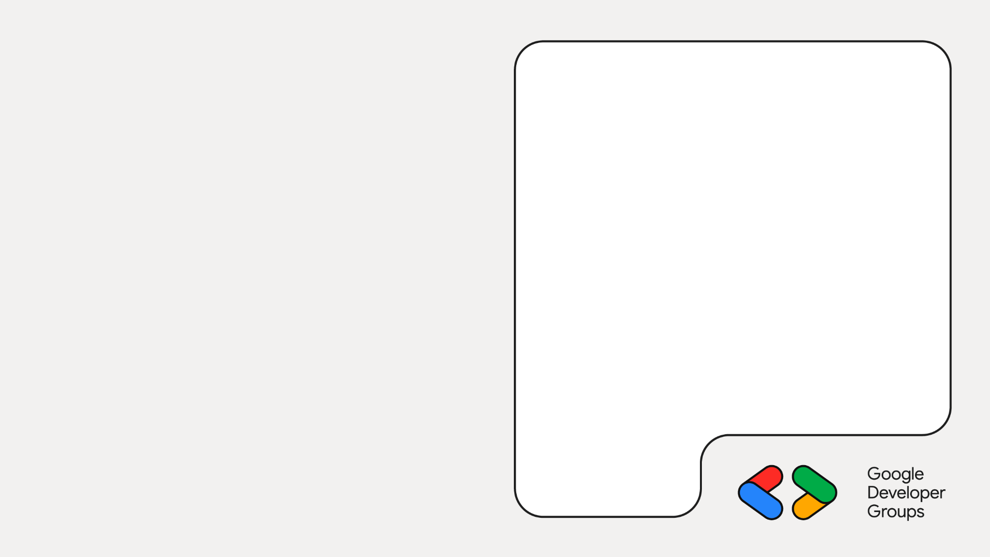

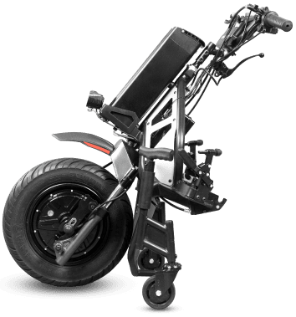
Images from tusonge.co.ke

Slide 20
06
The "Be Water" Strategy: Pitching the Nexus
Design your pitches based on the themes of available funding opportunities.

Slide 21
Find the nexus between your solution
(e.g., Sauti Salama's AI/ML) and the funder's problem (e.g., Tech for Climate Resilience, Digital Inclusion, Human Rights)
Traction is King: People fund traction, not ideas. Show users, connections, and iteration cycles.
The Payd Story
3 Fs - Friends Family, Fools

Slide 22
https://www.opportunitiesforafricans.com/
https://opportunitydesk.org/
https://opportunitiesforyouth.org/
https://www.globalsouthopportunities.com/

Slide 23
07
Claim to Fame: The Traction that Matters 🏆
Sauti Salama: Our Wins and What's Next

Slide 24
Global Recognition:
Participation in COP28, COP29, and COP30
Major Wins:
Unicef Gitex winner
Survivor Impact:
Over 400 cases reported and connected to critical legal, medical, and psychosocial support.
Policy making:
Kictanet
Google's Support: Free Tier, WIT
Tusonge as a Case study

Slide 25
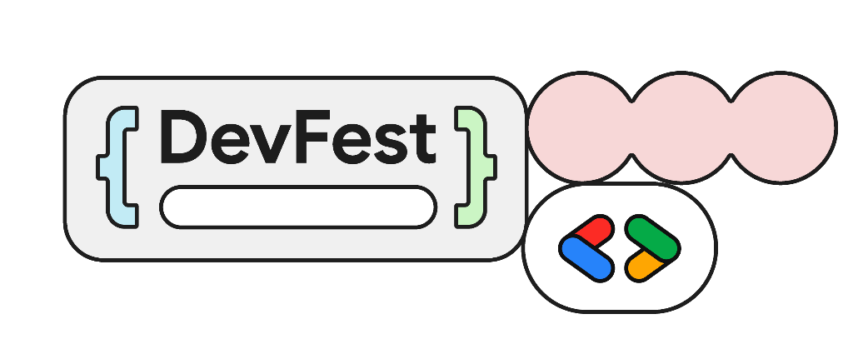
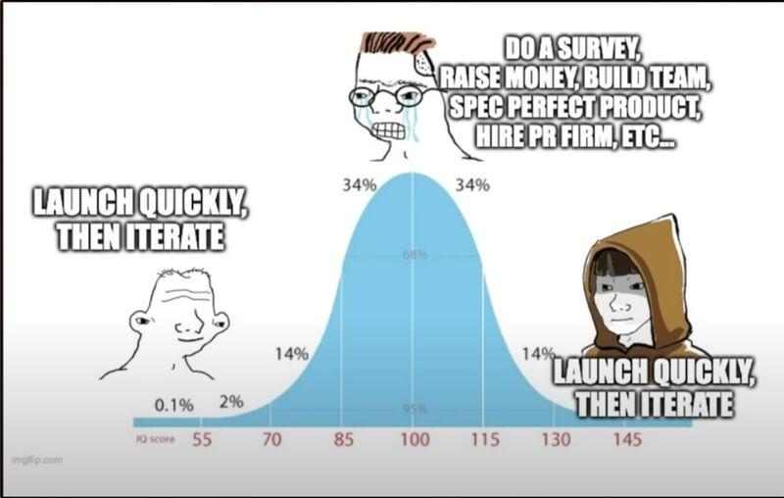
Sarice Centre
Ship, Learn, Iterate.
Oliver Wainaina
oliverwainaina.co.ke
https://media.licdn.com/dms/image/v2/D4D22AQG-cskDlGgXWQ/feedshare-shrink_800/feedshare-shrink_800/0/1691873374730?e=2147483647&v=beta&t=7niBISteSM3B09qQ9A9cMp7ERLnogdLSZzIWXZbIxvw

